Slide 1


NoSQL and MongoDB
NoSQL vs SQL, MongoDB
SoftUni Team
Technical Trainers
Software University
https://about.softuni.bg/

Slide 2

Table of Contents
Relational and Non-Relational Database
Database Scalability
CAP Theorem
Distributed Systems
NoSQL database types
MongoDB Overview
CRUD Operations

Slide 3
Have a Question?
sli.do
#csharp-db

Slide 4
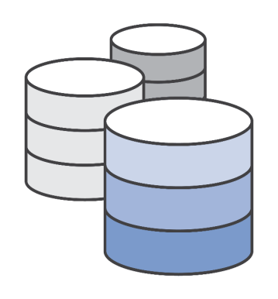

Relational and Non-Relational Databases
VS
Differences and Examples

Slide 5
Relational Database
Organizes data into one or more tables of columns and rows
Unique key identifying each row of data
Almost all relational databases use SQL to extract data
Relations between tables are done using Foreign Keys (FK)
Such databases are Oracle, MySQL, SQL Server, etc..
SELECT * FROM Students
5

Slide 6
Relational Database - Example
Table Pets
Table People
Id
Id
Name
Name
Age
Age
Color
Height
OwnerId
Email
Foreign Key

Slide 7
Non-relational Database (NoSQL)
NoSQL Databases are non tabular, and store data differently than relational tables
Key-value stores
SQL query is not used in NoSQL systems
More scalable and provide superior performance
{
"_id": ObjectId("59d3fe7ed81452db0933a871"),
"email": "peter@gmail.com",
"age": 22
}

Slide 8

Database Scalability

Slide 9
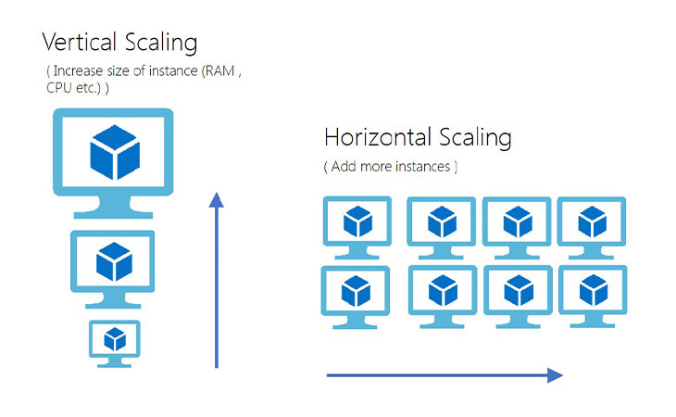
Database Scalability

Slide 10
Database Scalability
The ability of a system’s database to scale up or down, depending on the requirements
Enables the database to grow to a larger size to support more transactions
There are two types of database scalability:
Vertical Scaling or Scale-up
Horizontal Scaling or Scale-out

Slide 11
Vertical Scaling
Refers to the process of adding more physical resources to the existing database server for improving the performance such as:
Storage
Memory
CPU
Helps in upgrading the capacity of the existing database server

Slide 12
Vertical Scaling Pros and Cons
Pros:
It consumes less power
You need to handle and manage just one system
Cooling costs are less than horizontal scaling
Implementation isn’t difficult
Cons:
Risk of hardware failure which can cause bigger outages
Limited scope of upgradeability in the future

Slide 13
Horizontal Scaling
Adds more servers with less RAM and processors
The ability to increase the capacity by connecting multiple software or hardware entities in such a manner that they function as a single logical unit
If a cluster requires more resources to improve its performance and provide high availability, then the administrator can scale-out by adding more servers to the cluster

Slide 14
Horizontal Scaling Pros and Cons
Pros:
Easy to upgrade
Resilience is improved due to the presence of discrete, multiple systems
Supports linear increases in capacity
Cons:
It has a bigger footprint in the Data Center
Adds complexity to the system
Introduces data syncing problems
Dependent on the CAP theorem

Slide 15
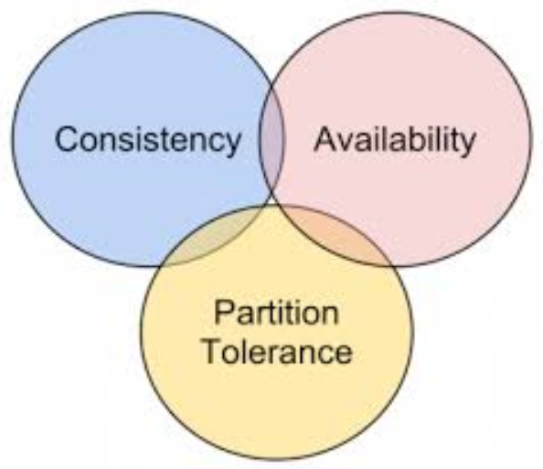
CAP Theorem

Slide 16
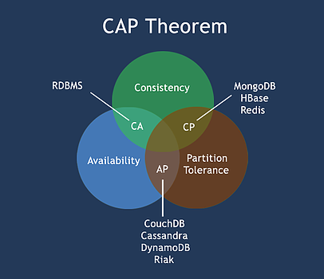
What is the CAP Theorem?
The CAP theorem states that a distributed system can deliver only two of three desired characteristics:
Consistency
Availability
Partition tolerance

Slide 17
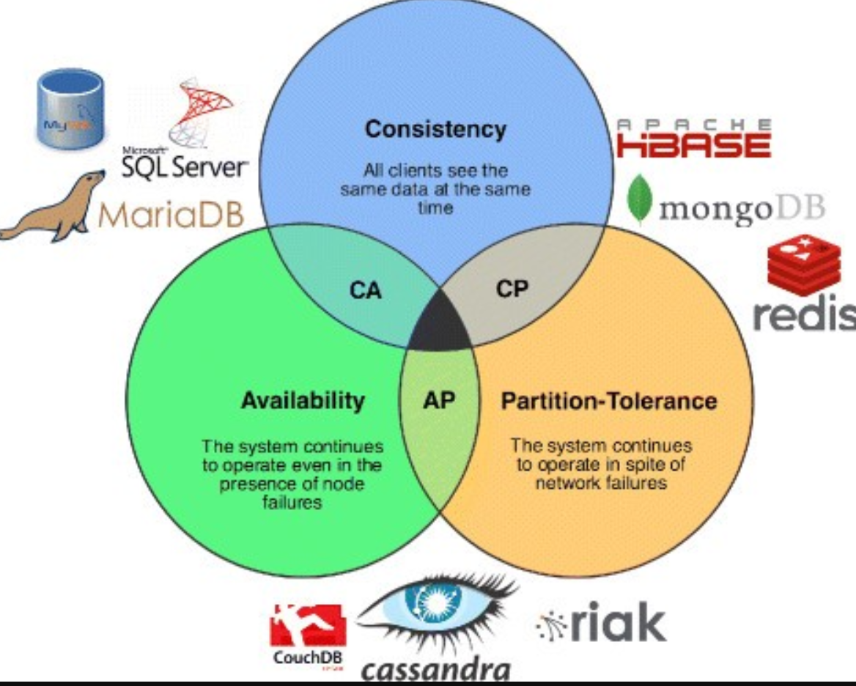
CAP

Slide 18
The 'CAP' in the CAP Theorem, Explained (1)
Consistency
All clients see the same data at the same time, no matter which node they connect to
Whenever data is written to one node, it must be instantly forwarded or replicated to all the other nodes in the system before the write is deemed 'successful'

Slide 19
The 'CAP' in the CAP Theorem, Explained (2)
Availability
Any client making a request for data gets a response, even if one or more nodes are down
Partition tolerance
The cluster must continue to work despite any number of communication breakdowns between nodes in the system

Slide 20

Distributed Systems

Slide 21
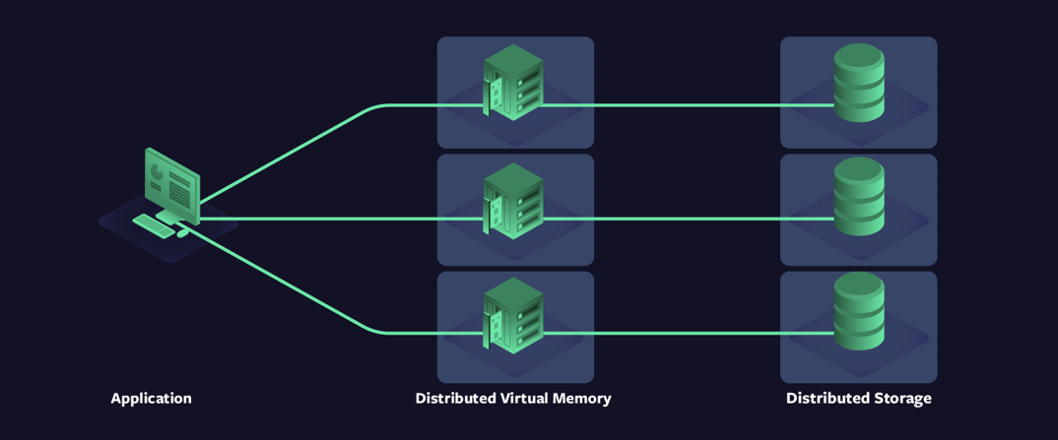
Distributed Systems
A network that stores data on more than one physical or virtual machines at the same time
NoSQL databases are often distributed, and the data is stored on multiple computers

Slide 22
8 Fallacies of Distributed Systems
The 8 fallacies are:
The network is reliable
Latency is zero
Bandwidth is infinite
The network is secure
Topology doesn’t change
There is one administrator
Transport cost is zero
The network is homogeneous

Slide 23
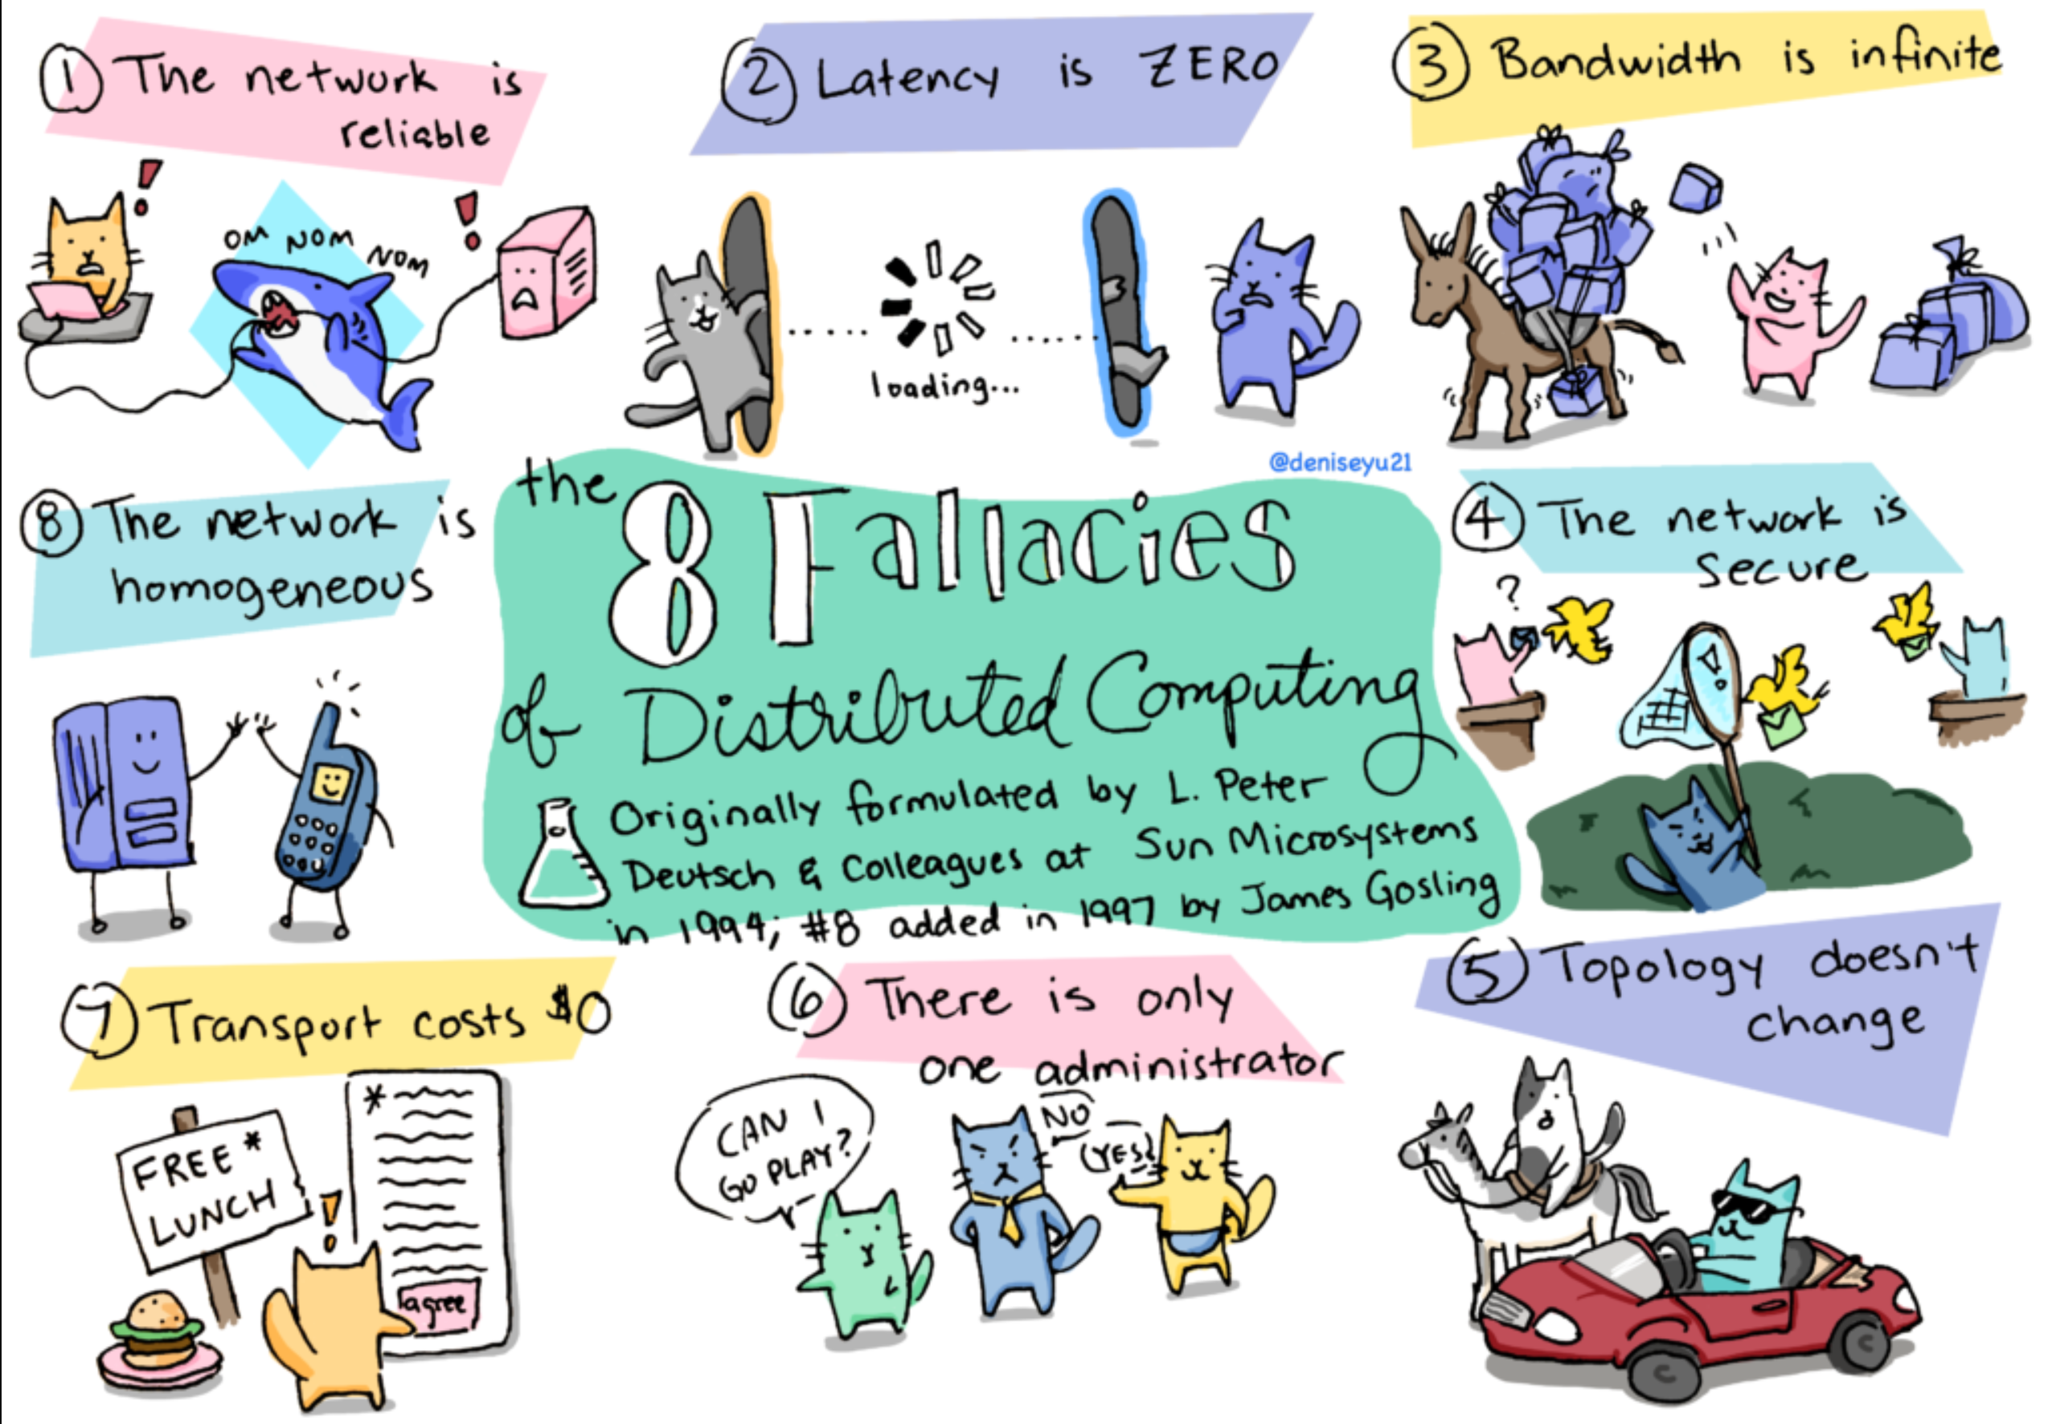
Cats and Fallacies

Slide 24
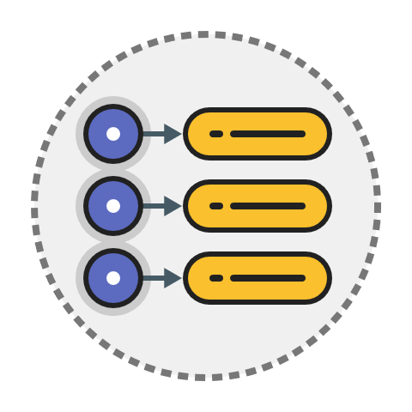
Key-Value Databases

Slide 25
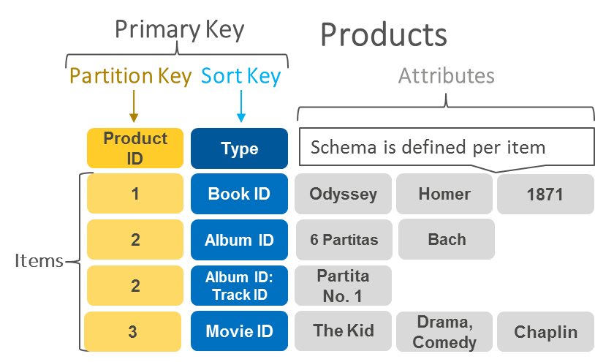
Key-Value Databases
Key-value databases work by storing and managing associative arrays
Keys serve as a unique identifier to retrieve an associated value
Values can be anything from simple objects, like integers or strings, to more complex objects
Example: DynomoDB

Slide 26

Document-Oriented Databases

Slide 27
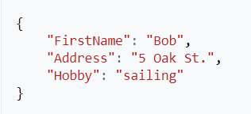
Document-Oriented Databases
Document-oriented databases, or document stores, are NoSQL databases that store data in the form of documents
Document stores are a type of key-value store:
Each document has a unique identifier
Document itself serves as the value
Usually stored as JSON, XML, Proto-Buff, etc.

Slide 28
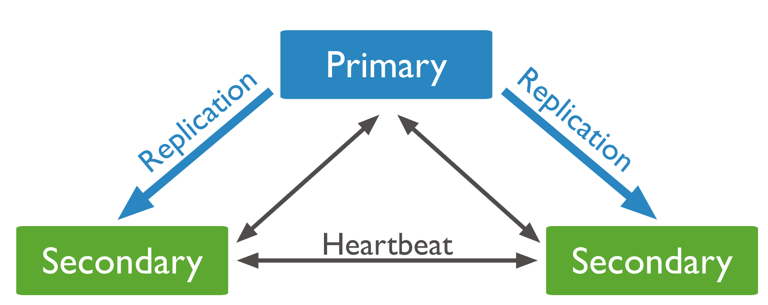
Replication
A replica set is a group of mongod instances that maintain the same data set
If the primary is unavailable, an eligible secondary will hold an election to elect itself the new primary
All reads and writes happen from the primary (configurable)

Slide 29
Sharding
Sharding is a method for distributing data across multiple machines
MongoDB uses sharding to support deployments with very large data sets and high throughput operations
Database systems with large data sets or high throughput applications can challenge the capacity of a single server

Slide 30
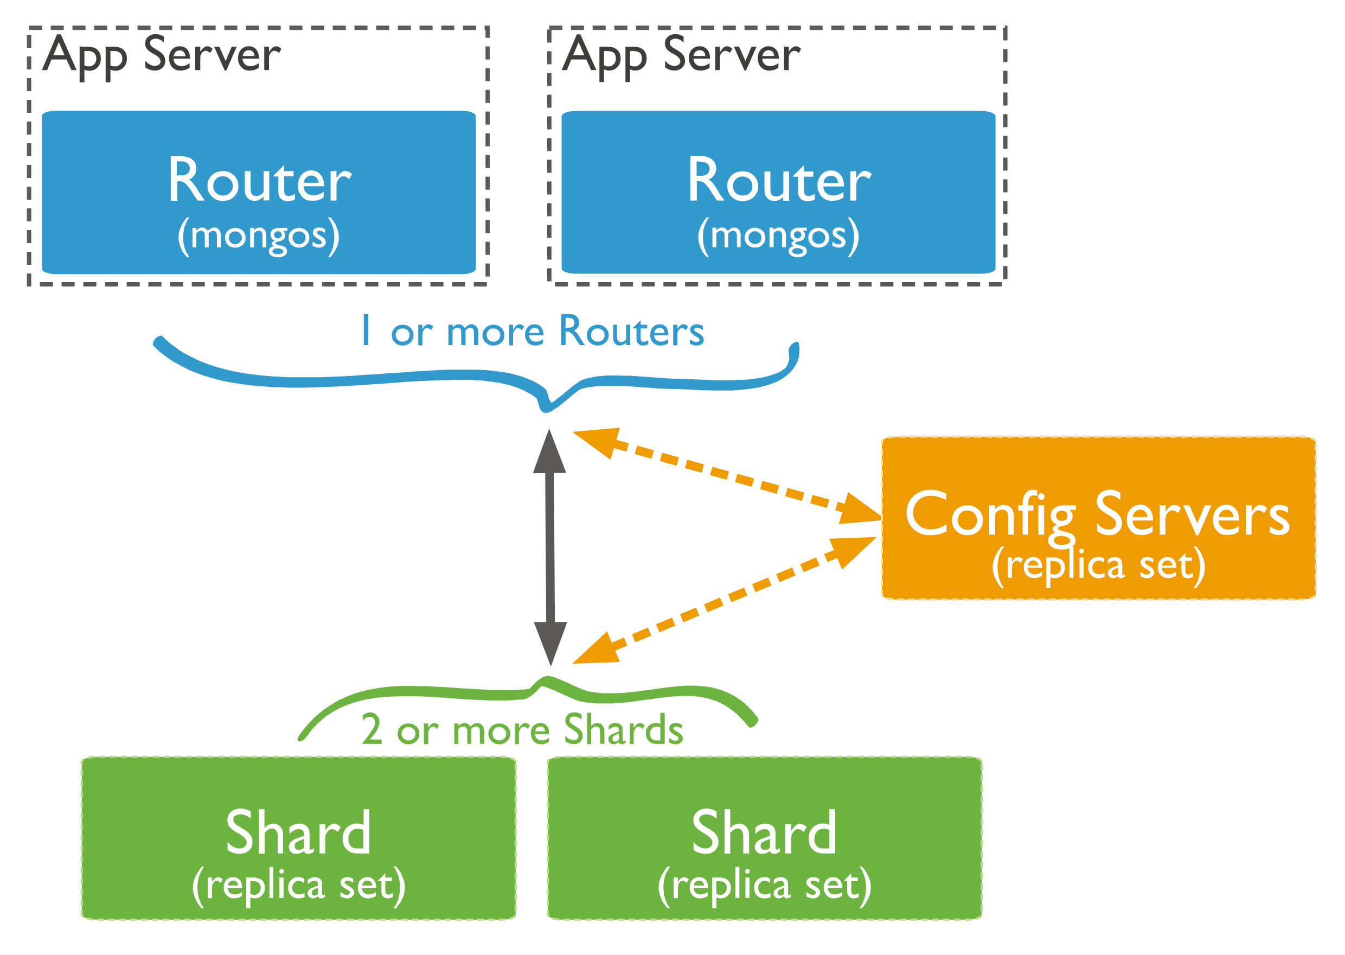
Sharded Cluster
A MongoDB sharded cluster consists of the following components:
Shard – each contains a subset of the sharded data
Mongos - a query router, providing an interface between client applications and the sharded cluster
Config Servers - store metadata and configuration settings for the cluster

Slide 31
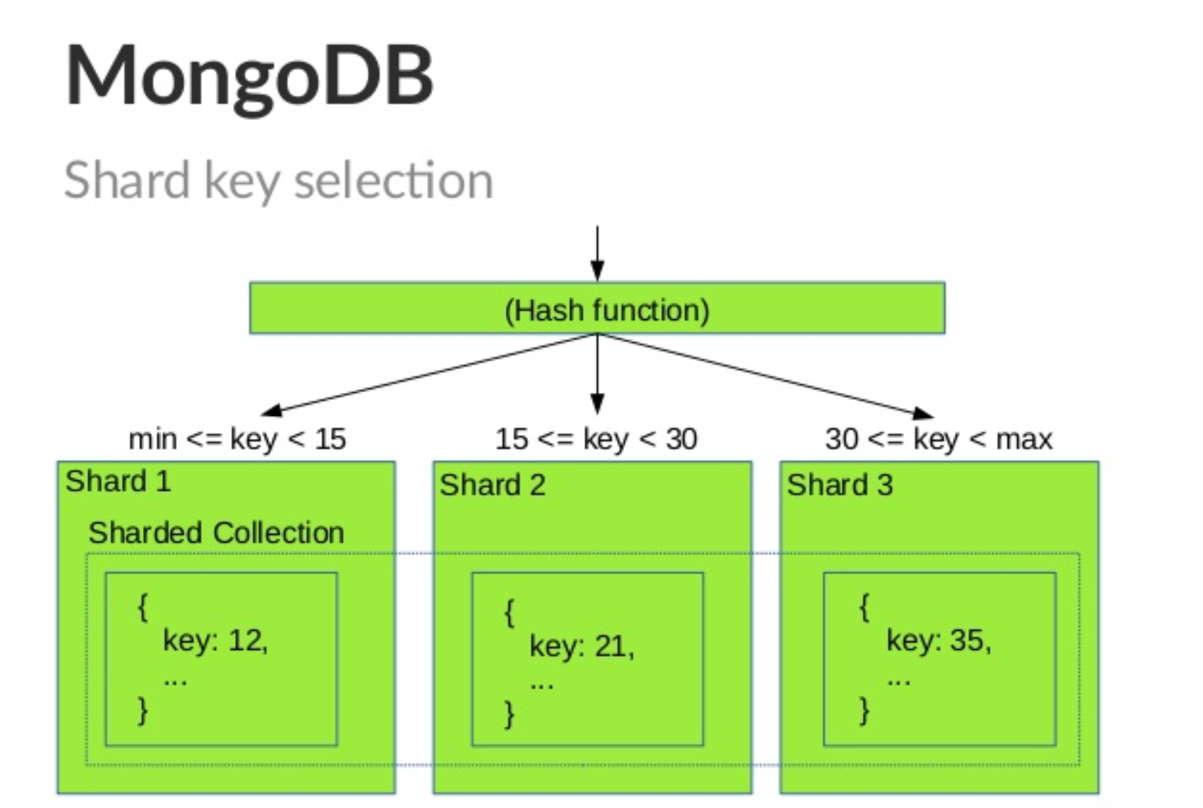
Sharding

Slide 32
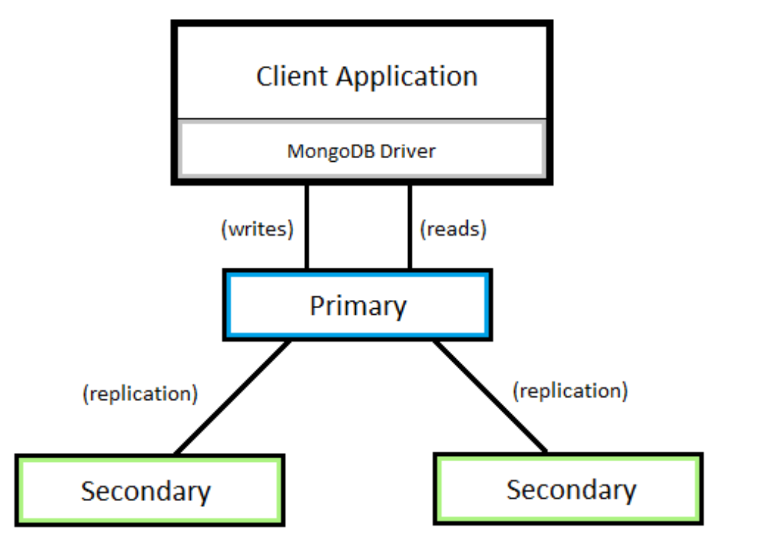
Replication

Slide 33

Columnar Databases

Slide 34
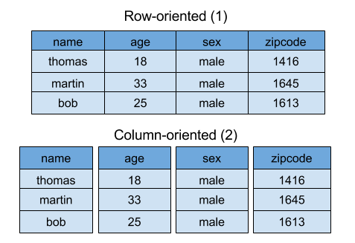
Columnar Databases
Columnar databases, are database systems that store data in columns
Each column is stored in a separate file or region in the system’s storage
Examples of columnar databases are Cassandra, Hbase, Redshift, etc.

Slide 35
Columnar Databases (2)
Key benefits of column store databases include faster performance in load, search, and aggregate functions
Column-oriented organizations are more efficient when an aggregate needs to be computed over many rows but only for a notably smaller subset of all columns of data
Not efficient when many columns of a row are required at the same time

Slide 36
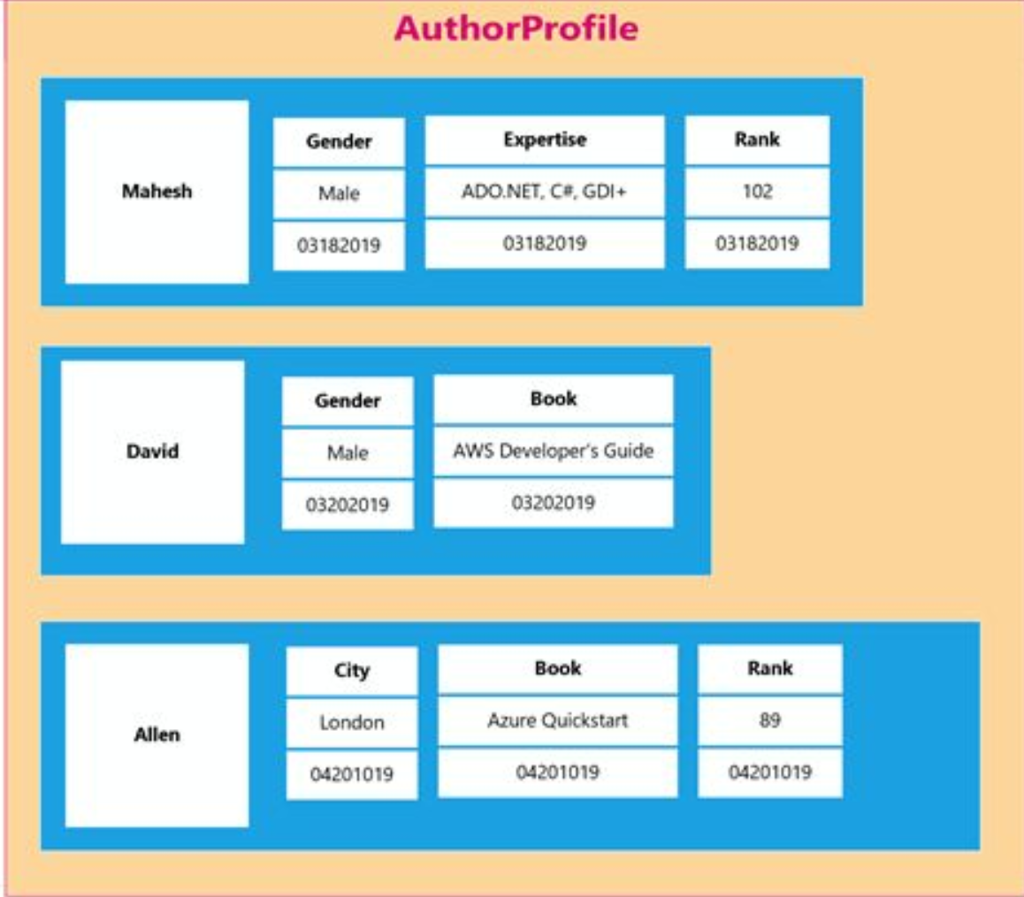
Columnar Databases (3)

Slide 37
Cassandra
Generally considered AP (in CAP)
Every node in the cluster has the same role. There is no single point of failure.
Data is distributed across the cluster (so each node contains different data)
Failed nodes can be replaced with no downtime.
Eventually consistent (configurable)
Uses CQL for queries

Slide 38
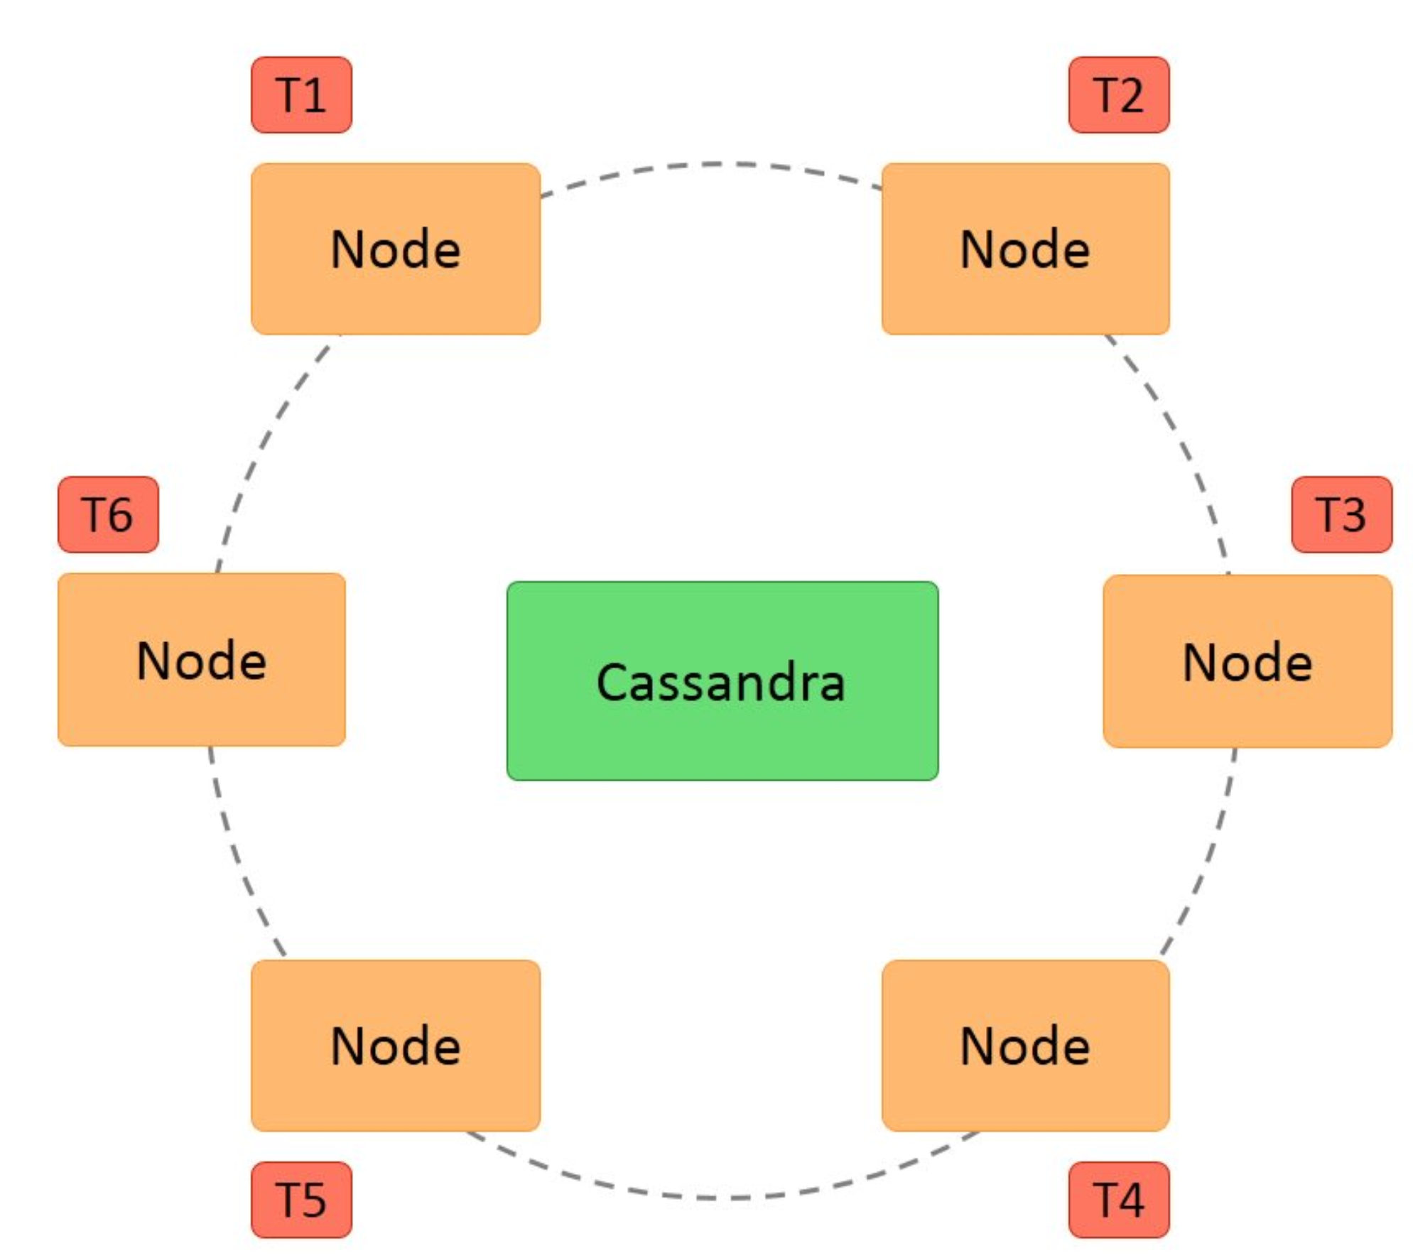
Cassandra (2)

Slide 39
Cassandra Usage
Discord switched to Cassandra to store billions of messages from MongoDB in November, 2015
Netflix uses Cassandra as their back-end database for their streaming services
Apple uses 100,000 Cassandra nodes
Uber uses Cassandra to store around 10,000 features
Many more applications

Slide 40

Graph Database

Slide 41
What is a Graph Database?
Allow simple and fast retrieval of complex hierarchical structures that are difficult to model in relational systems
No universal query language is present for graph databases (like SQL). Each database has own implementation of queries

Slide 42
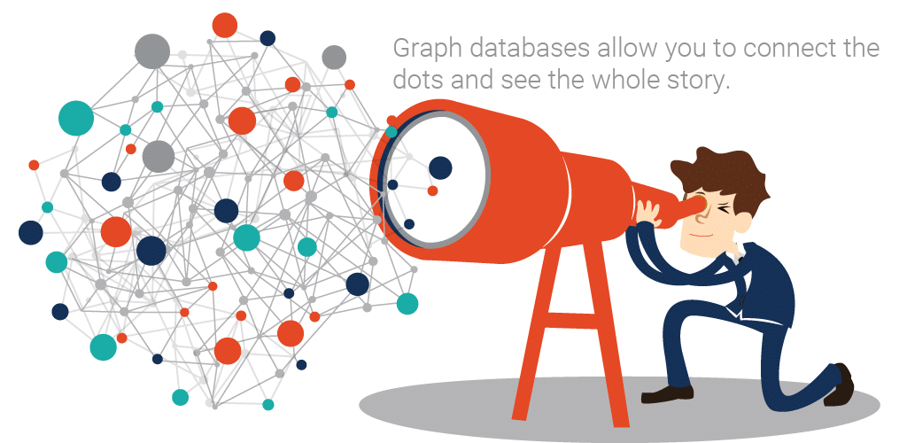
What is a Graph Database? (2)
A graph database contains a collection of nodes and edges
A node represents an object
An edge represents the connection or relationship between two objects

Slide 43
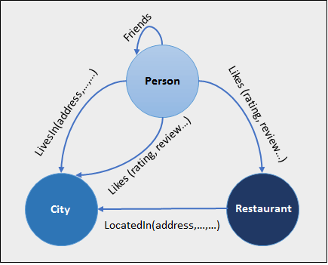
What is a Graph Database? (3)
Each node is identified by a unique identifier that expresses key- value pairs
Each edge is defined by a unique identifier that details a starting or ending node, along with a set of properties

Slide 44
MongoDB Overview
Installation, Configuration, Startup

Slide 45
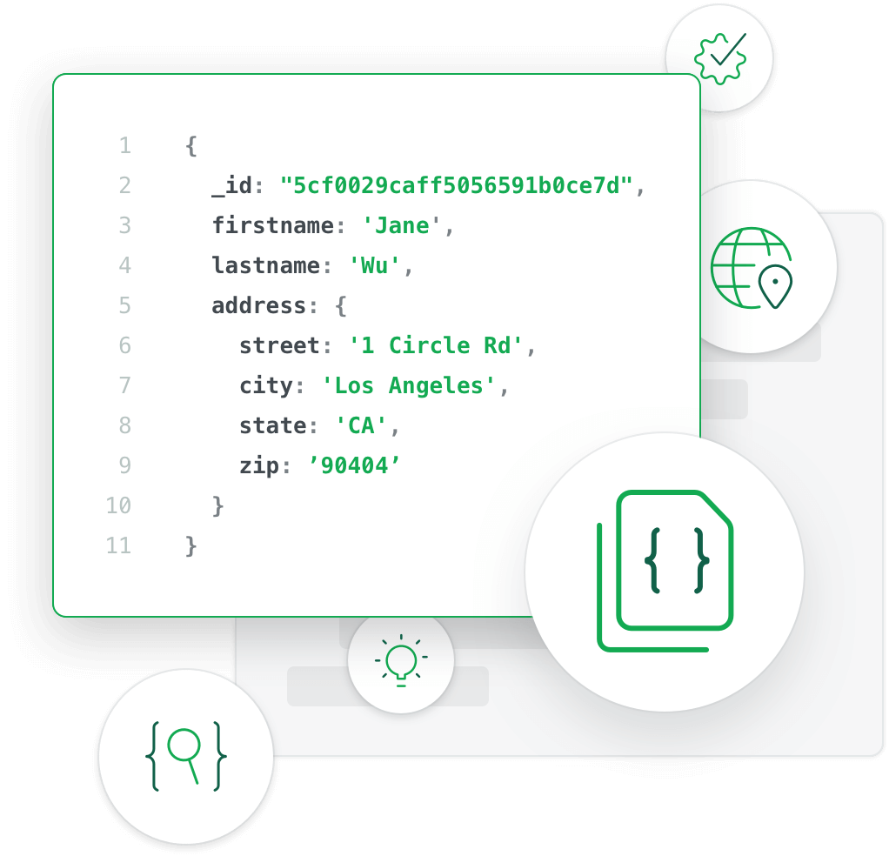
What is MongoDB?
MongoDB is a document database
It stores data in flexible, JSON-like documents
The document model maps to the objects in the application code, making data easy to work with
MongoDB is a distributed database at its core

Slide 46
Install MongoDB
Download from: https://www.mongodb.com/download-center
When installed, MongoDB needs a driver
One to use with Node.js, .NET, Java, etc..
MongoDB C#/.NET driver: https://docs.mongodb.com/drivers/csharp

Slide 47
Working with MongoDB GUI
Choose one of the many
For example:
Robo 3T-> https://robomongo.org/download
NoSQLBooster-> https://nosqlbooster.com
Compass -> https://www.mongodb.com/products/compass

Slide 48
Working with MongoDB Shell Client
Start the shell from a CLI
Type the command mongo
Additional information at: https://docs.mongodb.com/manual/reference/mongo-shell/
Shows all databases in the data folder
show dbs
use mytestdb
db.mycollection.insert({"name":"George"})
db.mycollection.find({"name":" George"})
db.mycollection.find({})
Gets all entries in the database

Slide 49
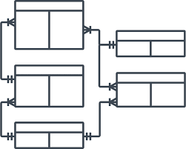
CRUD Operations

Slide 50
Connect to MongoDB
To connect to a MongoDB cluster, use the connection string for your cluster:
using MongoDB.Bson;
using MongoDB.Driver;
//…
var client = new MongoClient(
"mongodb+srv://<username>:<password>@<cluster-address>/test?w=majority" );
var database = client.GetDatabase("Example");
var collection = database.GetCollection<Interactions>("Interactions");

Slide 51
Select
To select a document use Linq:
var result = IMongoCollectionExtensions
.AsQueryable(collection)
.FirstOrDefault(s => s.SiteName == "Example");

Slide 52
Update
FindOneAndUpdate()
var update = MongoDB.Driver.Builders.Update.Set(s => s.SiteName, "New Example");
collection.FindOneAndUpdate(s => s.SiteName == "Example", update);

Slide 53
Delete and Insert
DeleteOne()
Deletes the first document that meets the filter
InsertOne()
Inserts a new document
collection.DeleteOne(e => e.Name =="Example");
collection.InsertOne(newItem);

Slide 54
Questions?
Notes:
54

Slide 55
Trainings @ Software University (SoftUni)
Software University – High-Quality Education, Profession and Job for Software Developers
softuni.bg, about.softuni.bg
Software University Foundation
softuni.foundation
Software University @ Facebook
facebook.com/SoftwareUniversity
Software University Forums
forum.softuni.bg
55
Notes:
55

Slide 56

License
This course (slides, examples, demos, exercises, homework, documents, videos and other assets) is copyrighted content
Unauthorized copy, reproduction or use is illegal
© SoftUni – https://about.softuni.bg
© Software University – https://softuni.bg
Notes:
56

